Slide 1


A REWARDING CAREER FOR YOU.
A BETTER LIFE FOR OTHERS.
A guide to careers in audiology; speech-language pathology; and speech, language, and hearing science

Slide 2
TYPES OF DISORDERS AUDIOLOGISTS AND SPEECH-LANGUAGE PATHOLOGISTS TREAT
Notes:
Ask the audience, “Which of these words stand out to you? Do you know someone who has experienced any of these disorders?”

Slide 3
WHAT IS COMMUNICATION SCIENCES AND DISORDERS (CSD)?
Getting started in a CSD career: It’s a matter of 1,2,3 . . .
Unlimited opportunities!
1
DISCIPLINE
CSD
2
CAREERS
Audiology
Speech-Language Pathology
3
PROFESSIONS
Audiologist
Audiology Assistant
Speech-Language Pathologist (SLP)
Speech-Language Pathology Assistant
Speech, Language, and Hearing Scientist
Notes:
A rewarding career with endless opportunities. Working with people across the lifespan—in schools, colleges and universities, health care, private practice, corporations, and industry; in cities and rural areas. Working in a career that is highly ranked, pays well, and offers opportunities around the world. If all of this sounds good to you, think about a career in CSD.

Slide 4

PICTURE YOURSELF MAKING A DIFFERENCE
By serving your community
By improving quality of life
By providing clinical services, conducting research, supervising, or managing services
Notes:
These careers offer so many benefits and opportunities. Not only does CSD offer many areas of employment, but these careers also help serve the needs of your community and improve quality of life.

Slide 5

MY PERSONAL WHY
Your Name Here
Write a brief statement of why you decided to become an Aud or SLP. Did someone inspire you? Are there groups of people you want to help?
Out loud, expand on this story.
Notes:
Presenter:
Write a brief statement of why you decided to become an Aud or SLP.
Did someone inspire you?
Are there groups of people you want to help?
Out loud, expand on this story.

Slide 6


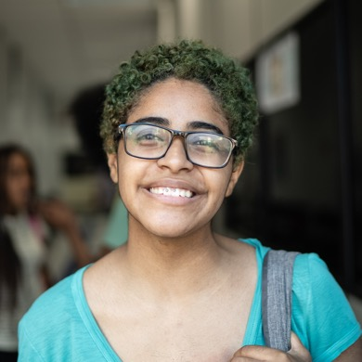

WHO YOU’LL WORK WITH
Babies
Children
Teens
Adults
In other words . . . people of all ages!
Notes:
Presenter: Please discuss the population that you work with or have worked with and your favorite part about working with that population.

Slide 7
WHERE YOU’LL WORK
AND WHAT YOU’LL DO
Colleges and universities
Corporations
Health care
Industry
Private practice
Research labs
Schools
Give a baby the opportunity to hear their parent’s voice for the first time
Develop groundbreaking research
Work with someone to regain their speech after a stroke
Help someone with hearing loss regain their hearing
Notes:
Presenter: Please discuss your current work setting or other settings that you worked in – a day in your life
Presenter: Please discuss some of your cases/clients and how you helped someone to improve their communication.
Many geographic areas have positions that offer flexibility to work with people of any age and in various settings—from universities and research labs to corporations to rural and urban settings.

Slide 8
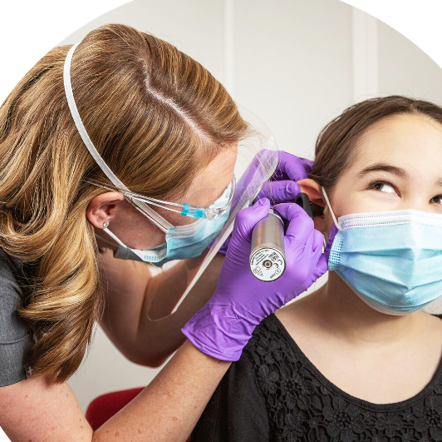
WHAT IS AN AUDIOLOGIST?
Audiologists are health care professionals who provide patient-centered care in the prevention, identification, diagnosis, and evidence-based treatment of hearing, balance, and other auditory disorders for people of all ages.
Notes:
Presenter: If you are an audiologist, please share why you chose audiology as your career.
If you aren’t an audiologist, read the description from the slide.

Slide 9
EXAMPLES OF WHAT YOU’LL
DO AS AN AUDIOLOGIST
Give a baby the chance to hear their parents’s voice for the first time
Work with an army vet on protecting their hearing while they are on duty
Help a grandparent hear their grandchildren
Teach a patient how to pair their hearing aid to their phone
Teaching a musician how to protect their hearing while on stage
Notes:
There are so many opportunities to explore as an audiologist.
Think about what interests you: Do you want to work in a health care setting, or be a business owner, or maybe a teacher? If you said yes to any one of those, you can be all those things as an audiologist.

Slide 10
AUDIOLOGISTS HAVE A LOT OF OPTIONS
Medical team−including medical specialists, speech-language pathologists, educators, engineers, and scientists
Clinic or private practice serving clients with hearing loss
College professor to train the next generation of clinicians
Develop leading research that changes the ability to communicate
Educate other audiologists on technology and testing equipment
Develop programs to protect people’s hearing in the workplace
Notes:
There are so many opportunities to explore as an audiologist. Think about what interests you: Do you want to work in a health care setting, or be a business owner, or maybe a teacher? If you said yes to any one of those, you can be all those things as an audiologist.

Slide 11
WHY AN AUDIOLOGY CAREER
1 in 5 teens have a measurable hearing loss
3 in 5 veterans returning from war report hearing loss or ringing in the ears (tinnitus)
12.5 percent of kids between the ages of 6 and 19 have hearing loss as a result of listening to loud music, particularly through earbuds at unsafe volumes
More than 1 million cochlear implants have been implanted worldwide
More than 90% of deaf children are born to hearing parents
22 million Americans—or about 22 percent— are exposed to hazardous noise levels in the workplace
Source: NIDCD, 2024
Notes:
There is a great need for audiologists—especially for those who are male, underrepresented, and/or bilingual—to address these hearing-related disorders. Employment of audiologists is projected to grow 16% through 2030, much faster than the average for all occupations.
Any sound that is loud enough and lasts long enough can damage hearing and lead to hearing loss. The effects of noise that can cause hearing loss varies among people. Many everyday items contribute to hearing loss: loud music, lawnmowers, vacuum cleaners, restaurants, heavy traffic, subway noise, and concerts−among many other items. You can protect your hearing by monitoring noise and volume levels.

Slide 12
TO BE AN ASHA-CERTIFIED AUDIOLOGIST, YOU NEED TO . . .
1. Earn a bachelor’s degree
2. Earn an AuD degree
3. Complete an externship
4. Pass the national exam
Notes:
A clinical doctoral degree (AuD) is required to work independently as an audiologist.
An AuD requires approximately 3–4 years of full-time study.
Degree requirements include both academic coursework and clinical practicum experiences.

Slide 13
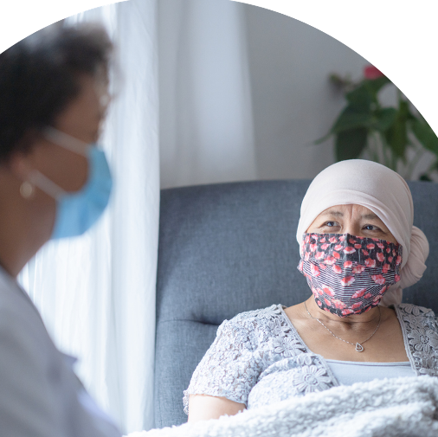
WHAT IS A
SPEECH-LANGUAGE PATHOLOGIST?
Speech-language pathologists are health care professionals who identify, assess, and treat speech, language and swallowing disorders in people of all ages.
Notes:
Presenter: If you are an SLP, please share why you chose audiology as your career.
If you aren’t an SLP, read the description from the slide.

Slide 14
EXAMPLES OF WHAT YOU’LL DO AS A SPEECH-LANGUAGE PATHOLOGIST
Help a child with stuttering
Teach a stroke patient how to swallow again
Teach a person and their care partners how to use an augmentative and alternative communication (AAC) device
Help a singer or performer maintain their voice
Work with kids who speak English as a second language learn to honor both language’s pronunciations
Notes:
Just like audiologists, SLPs have a lot of options, too. Most SLPs work in the schools, but you can do so much more. You can develop technology, new methods, or equipment to move the discipline forward. You can work in a corporate setting helping individuals improve their communication. You can help musicians and singers maintain their voice. In this career, you can engage in a wide range of employment options.

Slide 15
SLPS HAVE A LOT OF OPTIONS
Manage a university or hospital speech and hearing clinic
Serve patients in their private practice
Be an innovator who develops new methods and equipment to evaluate communication and related problems
Help employees improve communication with customers
Support students in preschool through high school
Help musicians and singers maintain their voice
Work as a college professor to train the next generation of clinicians
Notes:
Just like audiologists, SLPs have a lot of options, too. Most SLPs work in the schools, but you can do so much more. You can develop technology, new methods, or equipment to move the discipline forward. You can work in a corporate setting helping individuals improve their communication. You can help musicians and singers maintain their voice. In this career, you can engage in a wide range of employment options.

Slide 16
WHY A CAREER IN
SPEECH-LANGUAGE PATHOLOGY?
About 1 million people in the United States have Parkinson’s disease
Approximately 17.9 million adults in the U.S. have trouble using their voices
In the United States, about 3 million people stutter
Nearly 1 in 12 (7.7%) U.S. children ages 3–17 has had a disorder related to voice, speech, language, or swallowing in the past 12 months
Anyone can acquire aphasia (a loss of the ability to use or understand language), but most people who have aphasia are in their middle to late years. Men and women are equally affected. About 2 million people in the United States currently have aphasia.
Source: NIDCD, 2024
Notes:
There is a great need for SLPs to address these speech-related disorders—especially for those who are male, underrepresented, and/or bilingual. Employment of SLPs is projected to grow 29% through 2030, much faster than the average for all occupations.

Slide 17
TO BE AN ASHA-CERTIFIED
SPEECH-LANGUAGE
PATHOLOGIST, YOU NEED TO . . .
1. Earn a bachelor’s degree
2. Earn a master’s degree from a
CAA-accredited program
3. Complete a Clinical Fellowship (CF)
4. Pass the national exam
Notes:
A master’s degree (e.g., MA/MS) is required to work independently as a speech-language pathologist.
A master’s degree in speech-language pathology requires approximately 2 years of full-time study.
Degree requirements include both academic coursework and clinical practicum experiences.

Slide 18

WHAT IS A
SPEECH-LANGUAGE
PATHOLOGY ASSISTANT?
A speech-language pathology assistant (SLPA) is a support personnel who, following academic coursework, fieldwork, and on-the-job training, performs tasks prescribed, directed, and supervised by a certified and/or licensed speech-language pathologist.
Notes:
Presenter: If you are an SLPA, please share why you chose audiology as your career.
If you aren’t an SLPA, read the description from the slide.

Slide 19
SLPAS HAVE A LOT OF OPTIONS
Gain practical experience working with individuals of all ages who have speech, language, or swallowing disorders, enabling you to observe and actively participate in their therapy sessions
Utilize new technologies by training patients on how to use alternative communication devices
Assist as an interpreter or translator for patients or family members who may not speak English
Support the supervising SLP with their research projects, community outreach initiatives, and in-service training
Notes:
Most SLPAs work in the schools and work with SLPs.

Slide 20
WHY A CAREER AS AN SLPA?
High demand with a positive job growth outlook
The education requirement is less than that of an SLP, so you can enter the field sooner
It allows you to directly help people with communication challenges and gain valuable experience in CSD while working under the supervision of a licensed SLP
This role can be a stepping-stone to becoming a fully certified and licensed SLP
Can work as an SLPA while continuing your studies in graduate school
Work in diverse settings like schools, hospitals, and clinics, all while positively impacting people's lives
Notes:
There is a great need for SLPAs, and it is a role that you can do while in school.

Slide 21
SALARY INFORMATION
FOR SLPAS
Note: Data from the ASHA Career Portal https://on.asha.org/42ft65b
Notes:
Speech Language Pathology Assistant make $60,677 per year on average, or $29.17 per hour, in the United States. Speech Language Pathology Assistant on the lower end of that spectrum, the bottom 10% to be exact, make roughly $46,835 a year, while the top 10% makes $71,909. Location impacts how much a Speech Language Pathology Assistant can expect to make. Speech Language Pathology Assistant make the most in California and Florida

Slide 22
TO BE AN ASHA-CERTIFIED
SLPA, YOU NEED TO . . .
Review the three SLPA eligibility education pathway options and choose the one that best fits your education and qualifications
Complete the required clinical fieldwork hours and mandatory coursework
Submit your application
Pass the Assistants Certification Exam
Notes:
Mandatory requirements include:
100 hours of clinical field work (also called "clinical practicum" or "on-the-job hours") as an SLPA student or SLPA under the supervision of an ASHA-certified speech-language pathologist.
Complete a 1-hour course in ethics.
Complete a 1-hour course in universal safety precautions.
Complete a 1-hour course in patient confidentiality.
Complete ASHA’s online SLPA education modules, if required in your pathway option.

Slide 23

WHAT IS A SPEECH, LANGUAGE, AND HEARING SCIENTIST?
Speech, language and hearing scientists are health care professionals who conduct research into the normal functions of human communication, the processes underlying impaired function and the development of new techniques for assessment and treatment.
Notes:
Presenter: If you are a speech, language, and hearing scientist, please share why you chose speech, language, hearing science as your career.
What you’ll do
What you’ll earn
Who you’ll work with
Where you might work
As a speech, language, and hearing scientist, you will conduct the research that clinicians use to guide their work. You might investigate the biological, physical, and psychological processes of communication. Or you might explore the impact of psychological, social, and other factors on communication disorders. Your work could lead to new methods for diagnosing and treating individuals with speech, language, and hearing problems.
If you aren’t, please read the description from the slide.

Slide 24
SPEECH, LANGUAGE, AND HEARING SCIENTISTS HAVE A LOT OF OPTIONS
SLPs have a lot of optons
Collaborate with related professionals such as audiologists, SLPs, engineers, physicians, psychologists, and educators to conduct research
Work as a researcher in communication processes, new treatments, or behavioral patterns associated with communication disorders
Work as a university professor to train the next generation of clinicians
Provide consulting services to universities, hospitals, government health agencies, or industries
Notes:
As a speech, language, and hearing scientist, you may train the next generate of CSD professionals, conduct research that could make an impact on the professions, or provide consulting services to universities, hospitals, government health agencies, or industries.

Slide 25

LET’S TALK MONEY AND JOB SECURITY
Notes:
There are lots of career options out there, so when make your choice it is important to know about the salary and job security of each field you are considering.

Slide 26
SALARY
Audiologists
$90–120k
Speech-Language Pathologists
$75–110k
$75-110k
Salary ranges are the median annual salary can vary depending on a person’s area of focus, and their geographical area.
The nationwide median is 60k per year.
Notes:
Audiology and speech-language pathology roles offer a good salary and there are opportunities to specialize in different areas opening additional earning opportunities.

Slide 27
JOB RANKINGS
Audiologists
Speech-Language Pathologists
#12
#34
#3
#10
$75-110k
Highest paying jobs for people who want to work less than 40 hrs per week
Best Health Care Jobs
Best Health Care Jobs
Best Careers for the Next Ten Years
Ladders (2022)
U.S. News & World Report (2025))
U.S. News & World Report (2025))
Indeed(2024))
Notes:
Audiology and speech-language pathology careers are highly ranked.

Slide 28
SLPs have a lot of optons
INCREASE DIVERSITY
Individuals from Under-represented
Racial/Ethnic Backgrounds
Males
Bilingual Service Providers
Notes:
ASHA wants to increase diversity to create a more engaged and empowered membership, improve outcomes and lessen healthcare and educational disparities and an organization that is better able to serve an increasingly diverse constituent base.
In addition, a diverse and inclusive membership cannot exist with the current gender imbalance. Male clinicians are needed in the schools and in the healthcare environment. Increased numbers of male professionals provide more male role models for future generations of men to seek careers in the discipline and will add to the sustainability of the professions.

Slide 29
THE NEED FOR
MULTILINGUAL CLINICIANS
The top 10 most common languages nationally in health care encounters requiring interpretation are Spanish; languages commonly spoken in China (Mandarin and Cantonese); Vietnamese; Arabic; American Sign Language (ASL); Russian; Portuguese; Haitian Creole; and Korean.
Notes:
If you speak one of the languages listed above, it’s a great chance there is a job waiting for you.
With the changing U.S. demographics, there is a great need for clinicians who speak another language other than English. More than 50 languages other than English are commonly used in daily encounters between patients and health care providers in the United States.

Slide 30
GET STARTED NOW:
STEPS FOR HIGH SCHOOL STUDENTS
Visit the Hearing and Speech Careers website to learn more about
    audiology and speech-language pathology,
    how to plan your education, and
    financial aid.
Check out the high school roadmap to get started where you can learn more about CSD and entering this field.
Request a career brochure from ASHA.
Talk to your guidance counselor, the audiologist, or the
speech-language pathologist in your school about a career in CSD.
High School Roadmap
Notes:
If you are a high school student interested in a career in communication sciences and disorders (CSD), it’s never too early to start your journey by taking classes, gaining experience, and exploring undergraduate and graduate programs.

Slide 31

HOW TO FIND A COLLEGE
Tell your admissions officer your goal is to become an Audiologist or Speech-Language Pathologist and that you need a Communications Sciences and Disorders (CSD) program.
Visit ASHA Ed Find to search for a program near you!
Notes:
ASHA has created a database of programs that offer communication sciences and disorders programs, called EdFind. Check it out to find information about each program's length, class size, average accepted GPA, and more.

Slide 32

SCHOLARSHIPS & GRANTS
There are scholarships and grants for students who pursue degrees in communication sciences and disorders, speech, hearing, and language.
The National Student Speech Language Hearing Association (National NSSLHA) maintains a list of scholarships to consider.
Notes:
There are a number of scholarships and grants available to students pursing degrees in communication sciences and disorders. The National Student Speech Language and Hearing Association, also called NSSLHA, offers scholarships, resources, and more for students.

Slide 33

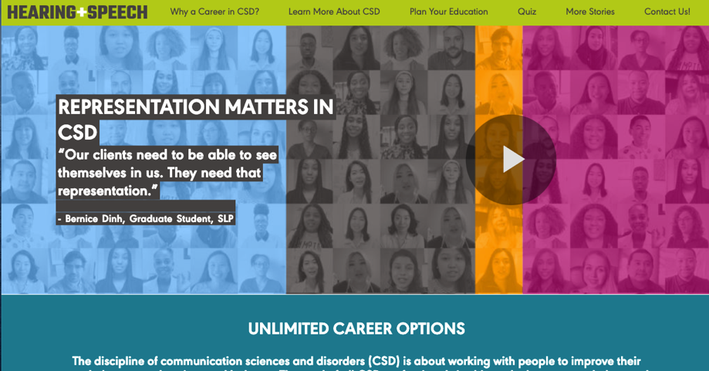
NEXT STEP
Visit hearingandspeechcareers.org to take our quiz to find out which career path is best for you and
sign up for more information.
Notes:
Now that you’ve learned what CSD is, what should you do next?

Slide 34

ABOUT ASHA
The American Speech-Language-Hearing Association (ASHA) is the national professional, scientific, and credentialing association for 241,000 members and affiliates who are audiologists; speech-language pathologists; speech, language, and hearing scientists; audiology and speech-language pathology assistants; and students.
Visit us at www.asha.org

Slide 35
THANK YOU FOR ATTENDING TODAY!
Presenter Contact Information
More questions: Email careers@asha.org
Notes:
Presenter: Please add your contact information

